Slide 1
Jibebe Internship 2022
Progress report
Electric team
Name: Amos Wanene

Slide 2
Tasks completed last week
[#1] Set project name – The project name was set as Jibebe in the a student meeting with Dr. Aoki.
[#12] Motor sizing for tricycle – The motor was appropriately sized for the load requirement. This was necessary because a small motor would not be sufficient to cater for a larger load whereas a large motor would operate low on its efficiency curve for a smaller load. Calculations can be found in the electric team folder of Jibebe repository with the title ‘Choice of battery for motor for tricycle’,
[#13] Determination of required electric components – Brainstorming was done by the team and a list of necessary equipment was made and generated. A Bill of Materials was prepared. A diagram can be seen in the next slide.

Slide 3
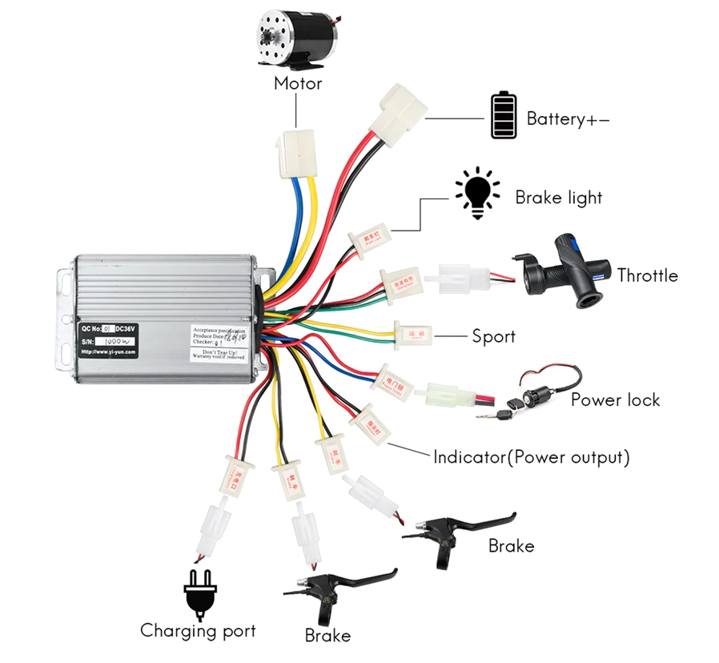

Slide 4
Tasks in this week
● [#14] Electric system experiments
● [#11] Mechanism for starting motor

Slide 5
Timeline
Month | Intern Week | Tasks
Jan | Week 1 | Design of required Battery Pack for Motor and Speed Control
 | Week 2 | Electric systems experiment
 | Week 3 | Testing of charging system
Feb | Week 4
 | Week 5
 | Week 6
 | Week 7

